Slide 1
Making the Most of our Surface Storage – a San Diego Story
San Diego County Water Authority
Amy Chen
MWD Program Chief
achen@sdcwa.org

Slide 2
Overview of Presentation
System Overview
Reservoir Systems
Regional Investments in Supply Reliability
Historical Use and Operations of Reservoirs
Conclusions

Slide 3
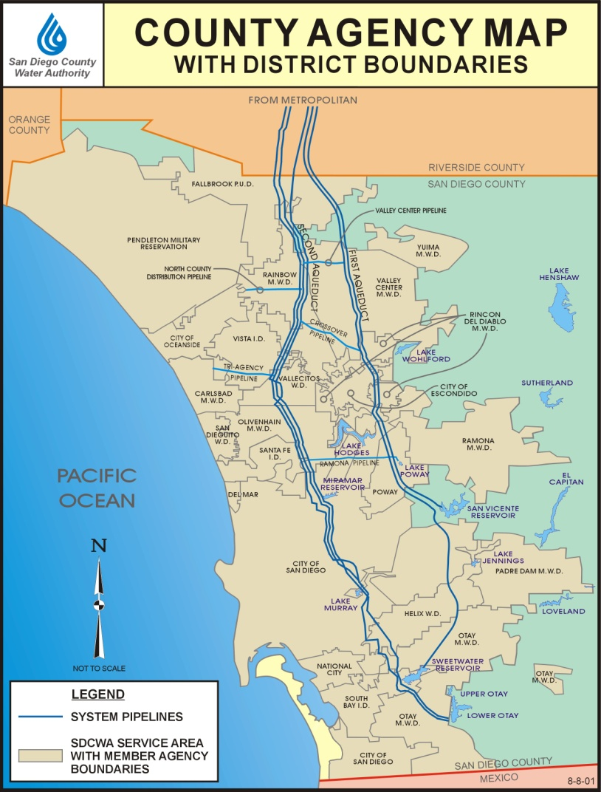
San Diego County Water Authority
The Water Authority formed in 1944 under County Water Authority Act
24 member agencies
36-member Board of Directors
Service Area
Approximately 3.1 million residents (97% of County population)
Regional economy of $186 billion
Facilities
300 miles of large diameter, gravity flow pipeline in two major alignments
131 service connections - treated and untreated
Dams, reservoirs, pump stations, hydroelectric facilities, treatment plant
Notes:
3

Slide 4
Water Authority Service Area Historic and Projected Normal Year Demands

Slide 5
San Diego Region Watersheds
San Juan
Santa Margarita
Orange County
San Luis Rey
San Diego County
Carlsbad
San Dieguito
Penasquitos
San Diego River
Imperial County
Pueblo
Sweetwater
Tijuana
Otay

Slide 6
San Diego County Reservoir Storage Overview
Reflects historic and modern investments
25 Reservoirs in the San Diego Region
Total Storage Capacity 590,000 AF
12 Supply reservoirs connected to aqueduct system
Current Regional Storage level is: 395,000 AF
Water Authority Storage is : 47,000 AF
Reservoirs are owned and managed by Member Agencies (Except Olivenhain)

Slide 7
Storage Pools by Reservoir

Slide 8
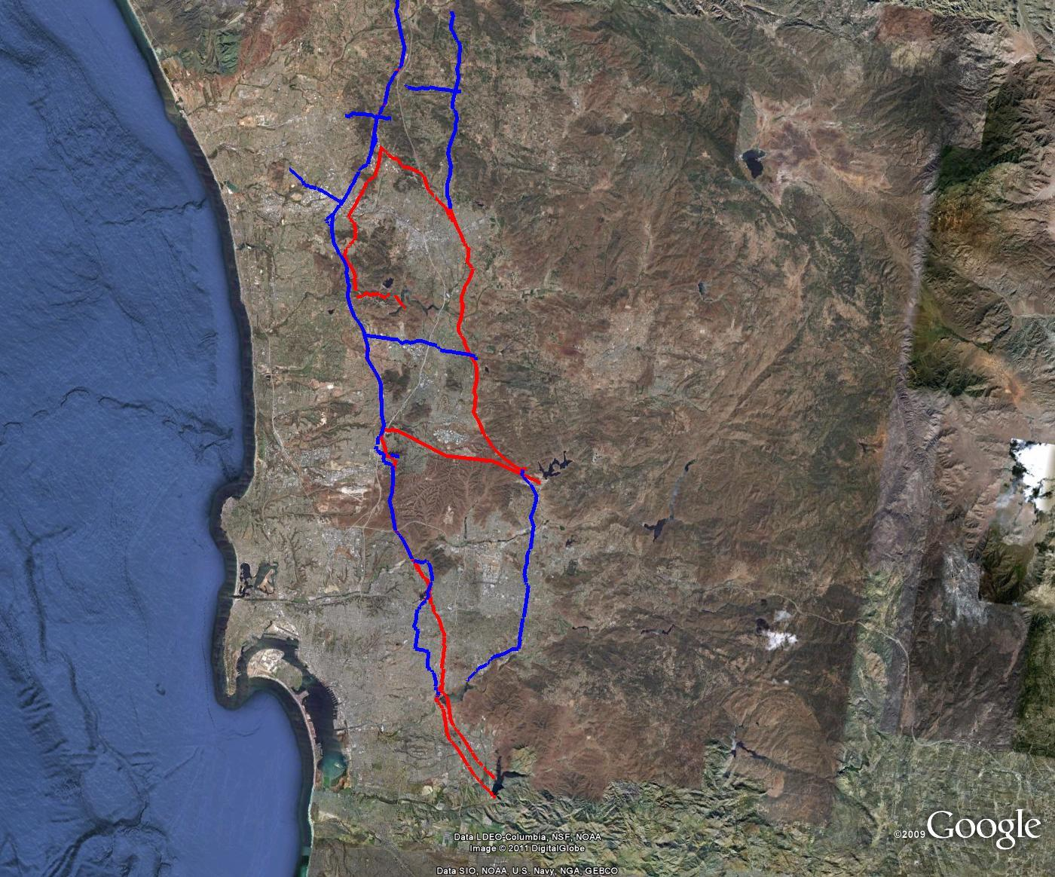
Total Storage = 61,000 AF
Treatment = 65 mgd
Total Storage = 58,000 AF
Treatment = 34 mgd
Henshaw
Escondido-Vista WTP
Wohlford
Total Storage = 243,000* AF
Treatment = 415 mgd
Dixon
Olivenhain
Olivenhain WTP
Hodges
Sutherland
Total Storage = 28,000 AF
Treatment = 106 mgd
Miramar WTP
Cuyamaca
Miramar
San Vicente*
Total Storage = 53,000 AF
Treatment = 30 mgd
El Capitan
Levy
WTP
Jennings
El Capitan
Murray
AlvaradoWTP
Loveland
Total Storage = 138,000 AF
Treatment = 40 mgd
Perdue
WTP
Sweetwater
Barrett
Otay
Morena
Otay
WTP

Slide 9
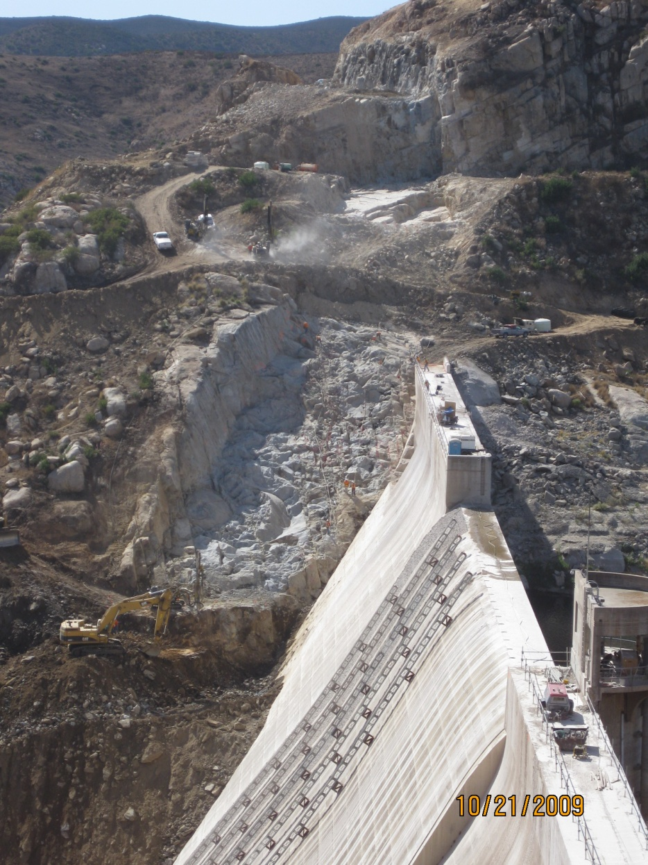
Regional Investments In Storage Operations and Conjunctive Use Since 2000
$2.5 billion regionally since 2000
$1.5 billion Emergency/Carryover Storage Project
New and expanded surface storage
Reoperation of existing reservoirs
$800 million in treatment to optimize conjunctive use of storage
Two new treatment plants
Expansion of three existing plants

Slide 10
ESP/CSP
200,000 AF of regional storage
One new reservoir and Dam (Olivenhain)
Raise of existing San Vicente Dam
Connect Lake Hodges to existing Aqueduct
Pipelines and Pump stations to optimize treatment and conveyance
Final Phase in Construction
San Vicente Dam Raise complete late 2012

Slide 11
Project: Olivenhain Dam & Reservoir
Complete: 2003
Cost: $198 million
Benefit: 25,000 AF of storage

Slide 12
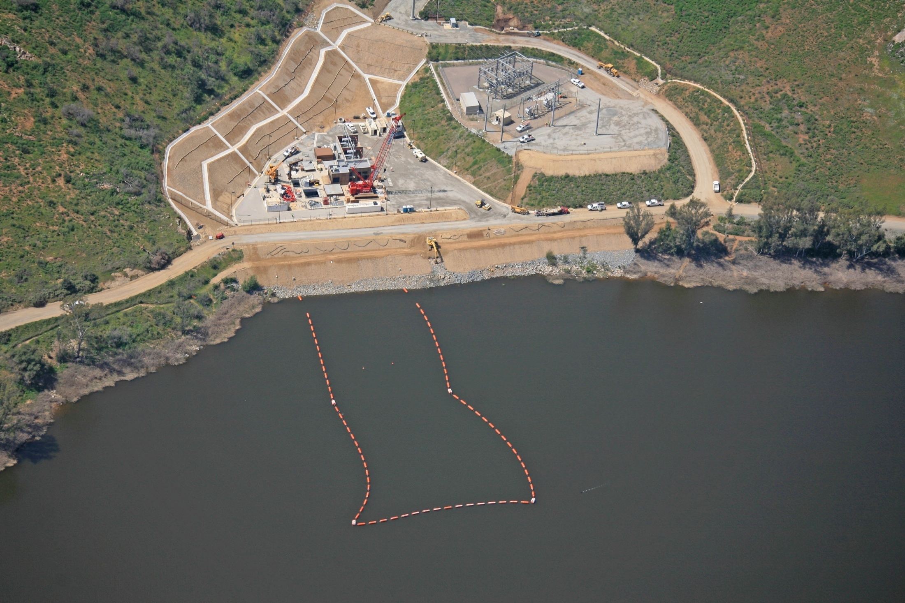
Project: Lake Hodges Projects
Complete: 2011
Cost: $196 million
Benefits: 20,000 AF ESP storage; 40MW power

Slide 13
Project: San Vicente Pipeline & Tunnel
Complete: 2011
Cost: $459 million
Benefit: Improved Water Delivery

Slide 14
Project: San Vicente Dam Raise
Complete: 2012
Cost: $482 million
Benefit: 152,000 AF of new storage

Slide 15
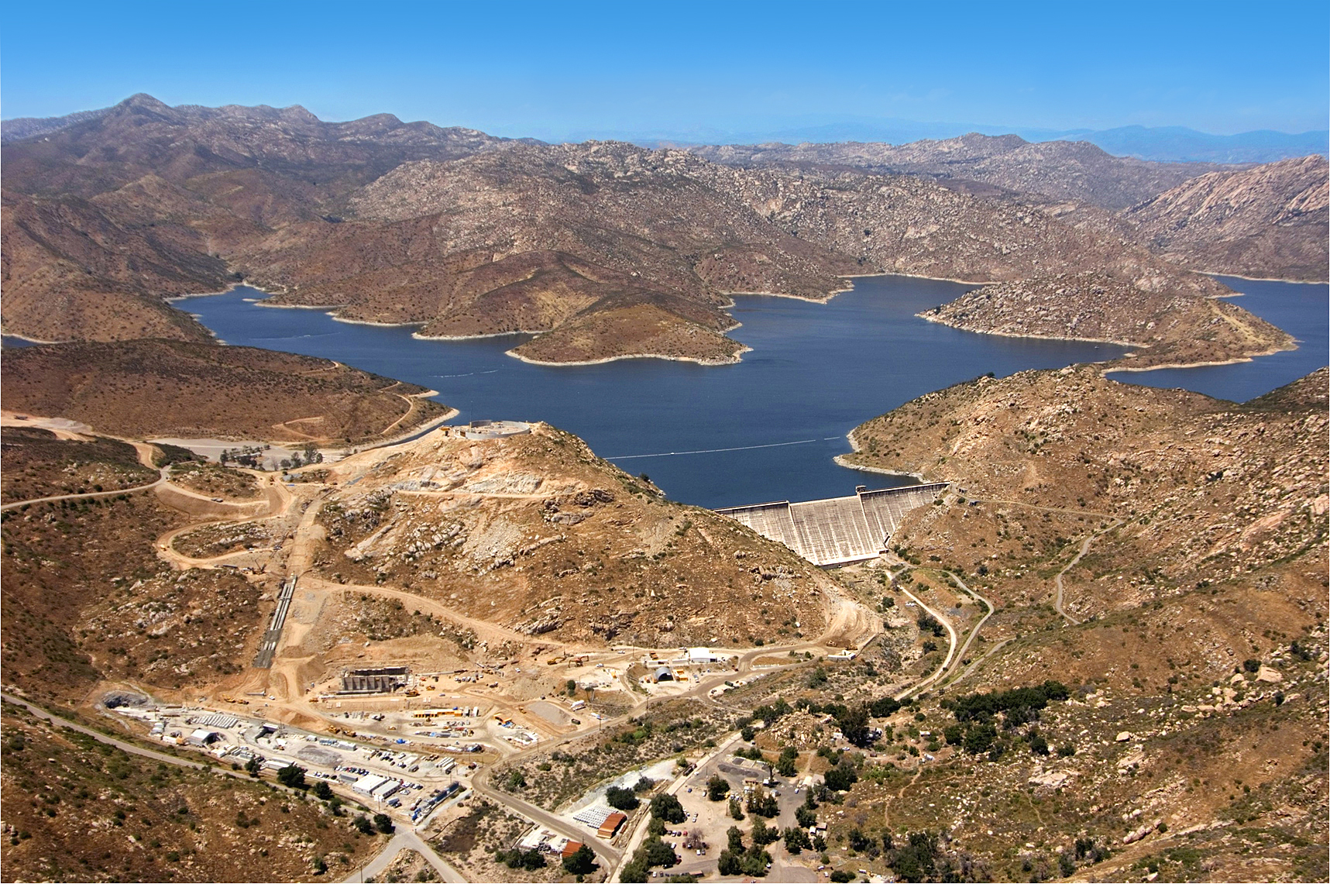
15
Notes:
Shows San Vicente Dam raise

Slide 16
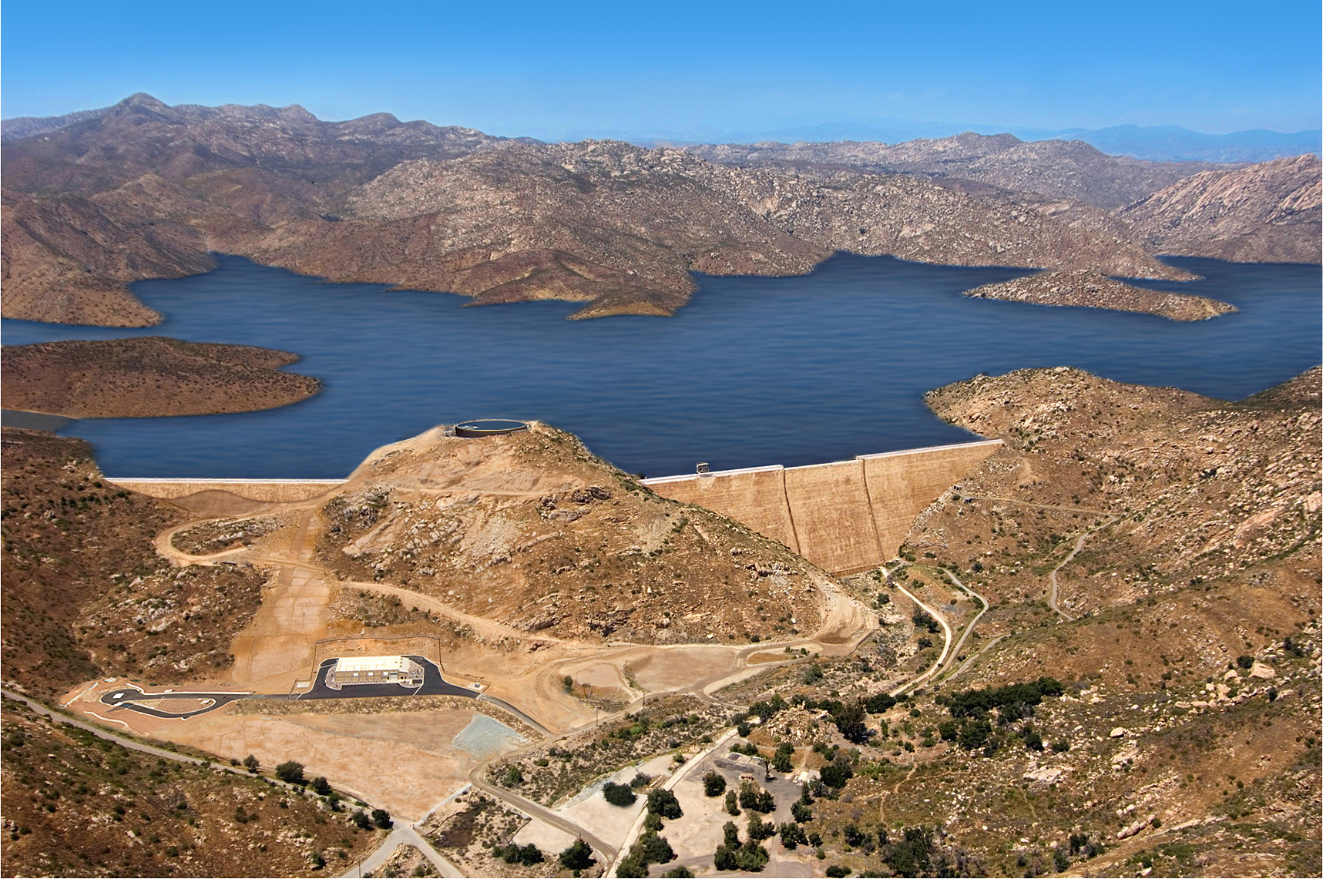
16

Slide 17
Project: Twin Oaks Water Treatment Plant
Complete: 2008
Cost: $179 million
Benefit: 100 MGD treated supply for region

Slide 18
San Diego Regional Investments in Treatment
Project | Cost
Levy Water Treatment Plant Expansion | $46,000,000
Olivenhain Water Treatment Plant | $98,000,000
Alvarado Water Treatment Plant Expansion | $202,000,000
Earl Thomas Reservoir upgrade | $31,000,000
Miramar Water Treatment Plant Expansion | $200,000,000
Otay Water Treatment Plant Expansion | $25,000,000
Otay Water Treatment Plant clear well | $10,000,000
Twin Oaks Valley Water Treatment Plant | $179,000,000
Total | $791,000,000

Slide 19
Multi-purpose Reservoirs
Capture local runoff
Annual yield
Average 59,600 AF
Seasonal shift of raw water demand from summer to winter to reduce summer peak demand
Managing variations in weather and runoff
Flood control considerations
Regulatory storage to feed water treatment plants

Slide 20
10 Year Reservoir Imported/Local

Slide 21
Actual Example of Using Reservoirs to Shift Peak Demands

Slide 22
Conclusions
Due to geologic constraints, limited groundwater basins in San Diego county
Surface reservoirs were built to capture runoff
Majority of reservoirs were built before imported water
Designed to maximize yield from local runoff
Since imported water deliveries, Water Authority has worked with member agencies to optimize use of imported water
Integration of regional system with member agencies systems
Additional reservoirs; conveyance system; treatment plants
Coordinated efforts continue today to ensure supply reliability and facility optimization

